Slide 1


Middle Eastern Biology of Parasitism Oyetunde Timothy Oyeyemi (Formerly Oyetunde Timothy Salawu) Parasitology Research Laboratory Department of Biological Sciences University of Medical Sciences, Ondo, Nigeria

Slide 2
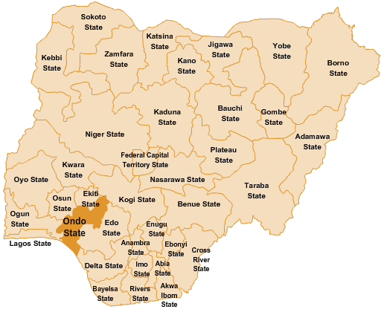
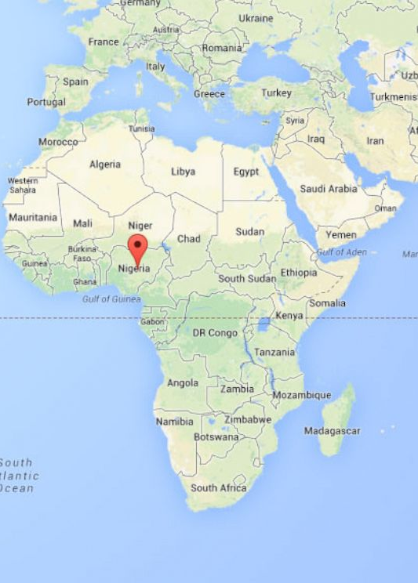
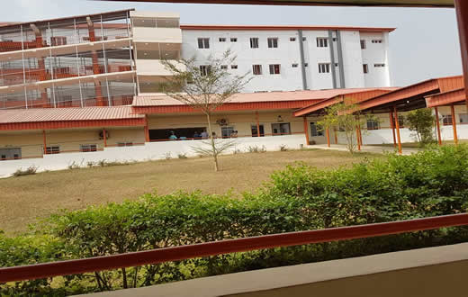
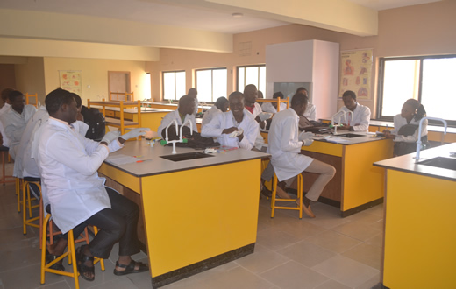

Slide 3
Overall Research Goal Control of parasitic infections in Sub-Sahara African countries
Epidemiology, morbidity quantification and diagnostics
Epidemiology of parasitic infections (schistosomiasis, malaria, trichomoniasis, filariasis)
Impact of co-infections on parasitic diseases severity
Malaria and schistosomiasis and effects on susceptibility and diagnosis
Malaria and schistosomiasis and effects on hematologic and renal-related disorder
Drug discovery against parasitic diseases
Indigenous plant materials against snails intermediate host of schistosomiasis
Determination of efficacy of novel nanoparticulate drugs against snail hosts
Conventional indirect diagnostic approaches and efficiency
Molecular epidemiology of intermediate hosts of schistosomiasis in Nigeria and dynamics of Schistosoma transmission
Interaction between malaria and hepatitis
Interaction between enteroviruses and intestinal parasites
Potency of some novel nanomedicines against malaria and trematode parasites

Slide 4
Present and Future Research Directions
Proteomics and diagnostics development for African-type schistosomiasis
Profiling of Schistosoma infected host serum for immunoreactive antigens
Proteome profiling in bladder pathology induced by Schistosoma haematobium infection
Immunogenicity of nanovaccine
Adjuvanticity properties of curcumin on Schistosoma worm tegument protein in PLGA delivery system
Immunogenicity of SWA using Moringa oleifera-derived glycosides in polymeric nanoparticles delivery system

Slide 5
Expertise and resources available
Expertise
Epidemiological data gathering
Resource available
Research field and biological samples
Cell culturing
ELISA
Drug formulation, design and testing
Data mining and analysis

Slide 6
Expertise required for next line of research
Bioinformatics for proteomes analysis
Flow cytometric
Gene cloning and expression
Electron microscopy

Slide 7
ACKNOWLEDGEMENTS
MEBoP Team
MEBoP Participants
Babcock University, Nigeria

Slide 8
Some Research outputs from our lab
Dauda, K., Busari, Z., Morenikeji, O., Afolayan, F., Oyeyemi, O.,* Meena, J., Sahu, D. and Panda A. (2017). Poly-D,L-lactic-co-glycolic acid-based artesunate nanoparticles; formulation, antimalarial and toxicity assessments. J Zhejiang Univ-Sci B (Biomed & Biotechnol), doi.org/10.1631/jzus.B1600389.2017
Oluwabiyi, B., Oyeyemi, O.T.,* Olorunlana, A., Omiyeniyi, N. and Koleosho A. (2016). Lymphatic filariasis in Southwestern Nigerian rural communities: a cross-sectional survey of the knowledge, awareness and predisposing factors. Annals of Global Health, 82(5): 806-812
Morenikeji, O.A., Adeleye, O., Omoruyi, E.C. and Oyeyemi, O.T.* (2016). Anti-Schistosoma IgG responses in Schistosoma haematobium single and concomitant infection with malaria parasites. Pathogens and Global Health, 110(2):74-78
Oyeyemi, O.T.,* Sode, O.J., Adebayo, O.D. and Mensah-Agyei, G.O. (2016). Reliability of rapid diagnostic tests in diagnosing pregnancy and infant-associated malaria in Nigeria. Journal of Infection and Public Health, 9(4):471-477
Morenikeji, O.A., Eleng, I.E., Atanda, O.S. and Oyeyemi, O.T.* (2016). Renal related disorders in concomitant Schistosoma haematobium-Plasmodium falciparum infection among children in a rural community of Nigeria. Journal of Infection and Public Health, 9(2):136-142
Oyeyemi, O.T.* and Amugo, A.N. (2015). Plasmodium falciparum and hepatitis B virus infection in Nigerian urban population. Brazilain Journal of Infectious Disease, 19(6): 666-667
Oyeyemi, O.T.*, Fadipe, O. and Oyeyemi, I.T. (2015). Trichomonas vaginalis infection in Nigerian pregnant women and risk factors associated with sexually transmitted diseases. International Journal of STD & AIDS. 27(13): 1187-1193
Akinwale, O., Oso, O., Salawu, O., Odaibo, A., Tang, P., Chen, T.W. and Gyang, P. (2015). Molecular characterisation of Bulinus snails – intermediate hosts of schistosomes in Ogun state, South-western Nigeria. Folia Malacologica, 23: 137-147

Slide 9
Thank you
for
your
audience

